Slide 1
Data collection from the simulation: UserActions
Lecture 6

Slide 2
In this lecture
We will discuss UserActions: RunAction, EventAction, StackingAction, TrackingAction and SteppingAction and how they can be used to control the simulation and collect data from it
Example: silicon strip detector and isotropic alpha source
We will use several methods to collect the “same” thing: distribution of alpha particles count on detector strips
We will use TrackingAction, accumulables and histograms for data acquisition
Strip detector will be created by using G4PVReplica
Number of strips will be controlled from main and distributed to DetectorConstruction, RunAction, EventAction and SteppingAction to create detector and data collection containers!

Slide 3
Structure of simulation
Let’s remember lecture 2 first:
Each call of BeamOn is a separate run. A run consists from events. Number of events is equal to number passed to BeamOn, and this is amount of times the GeneratePrimaries() from PrimaryGeneratorAction will be called. We can change simulation parameters – geometry, physics, etc - between runs, but not during the run.
Each primary particle can generate secondaries – electrons from ionization, recoils, gamma, etc. – depending on your physics list. They all will be tracked in the same event until they fly out of geometry or get stopped by some process or user action. After that, simulation of next event from the loop will start.
Each particle moves by steps. Step size comes from either a physics process or hitting a geometry boundary — whichever is shorter.

Slide 4
User actions
UserActions give us access to these different levels of simulation!
In RunAction you typically modify and change run-related things:
  In constructor you set up files and data collection containers for full run: accumulables, histograms, etc.
  In BeginOfRunAction you open files and reset histograms if needed
  In EndOfRunAction you merge files and analyze data after run finishes, get some run summary info: efficiency, total number of particles, etc.
  You dont’ change geometry in RunAction, geometry have been already built! It’s typically done through UIManager commands between beamOn in main - will see in the next lectures!
In EventAction you typically modify and change event-related things:
  In class itself you typically add containers which will collect data from event
  In BeginOfEventAction you empty them
  In EndOfEventAction you check conditions/triggers, select and fill accumulated data to the histograms
  Data to EventAction containers typically comes from SteppingAction or TrackingAction - you pass a pointer to your EventAction to them!
In TrackingAction you observe behaviour of track:
  You can get particle properties before first step and get name, position, direction, energy, etc. in PreUserTrackingAction
  PostUserTrackingAction - similarly you can get particle final state after last step
  Typical uses - count particles, count number of secondaries of some type, store trajectories, get range, total step number

Slide 5
User actions
In SteppingAction you get access to each step of particle tracking:
  UserSteppingAction runs after each step - it should be efficient!
  You get access to all particle properties: pre- and post-step positions, time, velocity, kinetic energy, position, momentum, charge, etc.
  You get the volume in which particle is, what is total deposited energy to a volume on this step and what is non-ionizing part of this energy deposition (GetTotalEnergyDeposit(), GetNonIonizingEnergyDeposit()).
  You get what process defined the step and how many secondaries was created on this (GetSecondaryInCurrentStep())
  You also get access to track - ID, ID of parent particle, which process created it
  You can change status of a track: fStopAndKill - stop tracking of the particle, fKillTrackAndSecondaries - stop tracking of the particle and all its secondaries
  From this you can organize whatever data collection you need!
In StackingAction you get access to stack of tracks:
  Stack is vector of tracks which Geant4 needs to finish for this event
  At the beginning of event loop a primary is added to it. Primary generates secondaries, which are added to the stack, and in StackingAction you can control which particles will be tracked!
  ClassifyNewTrack is called at each addition to the stack, ad depending on what it returns - you can decide what will happen to a track!
  Main return values: fUrgent - urgent stack, fWaiting - waiting stack, fKill - track is deleted. Without StackingAction all tracks are put in the urgent stack!
  Useful to stop tracking some unwanted particles - but you lose energy conservation, energy of kileld tracks will be just lost!
  Also useful to count secondaries!
  You can also move tracks from between urgent and waiting stacks. In NewStage() function after all urgent tracks are finished, you can do some intermediate analysis and kill some unwanted waiting tracks and only track what you need

Slide 6
Structure of simulation
Let’s put all user actions into the simulation loop:
runManager->Initialize(); - geometry, physics, threads start. Build() from ActionInitialization creates user actions
runManager->BeamOn(N); - one run:
RunAction::BeginOfRunAction() – done before first event
Cycle for each of N events:
PrimaryGeneratorAction::GeneratePrimaries() - we get our primary
StackingAction::PrepareNewEvent() - do something here if you want
EventAction::BeginOfEventAction() - empty our containers and prepare them for data collection
Then primaries become tracks and go to the stack: StackingAction::ClassifyNewTrack() for each (without StackingAction all go to the urgent stack)
While stack is not empty - take the last track from it and and simulate it:
TrackingAction::PreUserTrackingAction() - collect necessary information in the beginning of track
after each step: SteppingAction::UserSteppingAction() - collect necessary information in step
TrackingAction::PostUserTrackingAction() - collect necessary information after track stopped
secondaries of this track go to the stack: StackingAction::ClassifyNewTrack() for each
When urgent stack is empty: StackingAction::NewStage() - tracks from waiting stack (if any) go to urgent stack
EventAction::EndOfEventAction() - check conditions, fill hisograms
RunAction::EndOfRunAction() - merge accumulables, analyze data from full run
Same structure as before: run - event - track - step, and each level has its own user action!
Tracks are taken from the stack last-in-first-out: the newest secondary is tracked first. So tracks are not processed in time order!

Slide 7
Multithreading
Lecture 2: in MT mode each worker thread simulates its own event loop, master only manages them!
Lets look at ActionInitialization:
BuildForMaster() is called once for master thread, master does not simulate events, but it has its RunAction
Build() is called once in each worker thread - all user actions are created for this thread
  With 20 threads you have 21 RunAction, 20 EventAction, 20 SteppingAction objects, etc – see lecture 2 list of thread local and shared objects.
  SteppingAction of a thread fills EventAction of the same thread - data from different threads is not mixed!
Constructors of user actions are called once per thread - create histograms and accumulables there
  BeginOfRunAction is called at each BeamOn - if you create histograms there, you create them again for each run!
Master BeginOfRunAction is called before workers start the run, master EndOfRunAction - after all workers finished
  Workers call Write() and Merge() in their EndOfRunAction - it adds their histograms to master histograms and unites accumulables data
  So in master EndOfRunAction all data is ready for analysis!
  This is why we check isMaster in EndOfRunAction when we print or analyze results

Slide 8
Example: silicon strip detector
Our goal: collect the more or less the same thing - distribution of alpha particles over detector strips - with different methods and compare!
Each method has its own definition of “alpha hit this strip”. Results look the same, but they are not exactly the same - you should know what you actually count!
Setup:
  Silicon detector 100 x 100 mm, 300 um thick, divided into 100 strips of 1 mm along X
  ²⁴¹Am point source 5 cm in front of detector center, isotropic, everything in vacuum
  4 main alpha lines of ²⁴¹Am are sampled with discrete cdf
  Physics list is like in lecture 2: ionisation and Coulomb scattering, but now for alpha
  Alpha is a separate particle in Geant4, it is not GenericIon! Processes registered for GenericIon will not work for alpha
  But GenericIon still must be defined - otherwise Geant4 stops with “Missing GenericIon” error
  Electrons also have ionisation and scattering, cut is 1 um - so we can look at secondarie

Slide 9
Parameters from main
Detector size and number of strips are set only once - in main:
const G4double Xlength = 100*mm;
const G4int Nstrips = 100;
auto detConstruction = new DetectorConstruction(Xlength, Ylength, Zthickness, Nstrips);
auto actionInitialization = new ActionInitialization(Xlength, Nstrips);
ActionInitialization keeps them as class members and passes them to user actions when it creates them:
auto* runAction = new RunAction(fXlength, fNstrips);
SetUserAction(runAction);
auto* eventAction = new EventAction(fXlength, fNstrips);
SetUserAction(eventAction);
SetUserAction(new SteppingAction(eventAction, runAction, fXlength, fNstrips));
Change number of strips in main - detector, containers and histograms change with it! No need to fix the same number in 4 different files!
SteppingAction also gets pointers to EventAction and RunAction to fill their containers - like in lecture 2

Slide 10
Strips with G4PVReplica
We create detector box, then one strip, and fill the detector with copies of this strip:
auto *stripS = new G4Box("Strip",stripX/2., fY/2., fZ/2.);
new G4PVReplica("Strips", stripLV, DetectorPV, kXAxis, fNstrips, stripX, 0);
Arguments: name, logical volume of one copy, mother volume, axis along which your copy is made, number of copies, width of one copy, offset
Replica must fill the mother volume completely and must be its only daughter!
Axis can be kXAxis, kYAxis, kZAxis - decartes, kRho or kPhi - polar – see the documentation for details:
https://geant4-userdoc.web.cern.ch/UsersGuides/ForApplicationDeveloper/html/Detector/Geometry/geomPhysical.html#repeated-volumes
Copies are numbered from 0 at -X to N-1 at +X: center of copy i is at -width*(N-1)/2 + i*width
Only one physical volume object is created for all 100 strips - Geant4 changes its copy number during navigation
  So get strip number from touchable - it remembers where exactly the point is:
  G4int strip = preStepPoint->GetTouchable()->GetCopyNumber()
  preStepPoint->GetPhysicalVolume()->GetCopyNo() – can’t be used here, it will already give the number of the next strip if particle went through strip boundary!

Slide 11
Four ways what strip distribution could mean
All strip histograms have the same X axis: 100 bins from -50 to 50 mm - one bin is exactly one strip!
We will use 4 ways to get similar distribution:
1. EventAction: SteppingAction adds deposited energy of each step to its strip. In EndOfEventAction we calculate energy weighted mean position and fill it
2. TrackingAction: in PostUserTrackingAction we fill X of the point where primary alpha stopped in detector
3. Accumulables: SteppingAction adds 1 to the strip where alpha entered the detector. At the end of run workers merge accumulables into master and it fills the histogram
4. SteppingAction: same condition as 3, but histogram is filled directly from stepping action
Plus histogram of total deposited energy in detector (EventAction) - to see the effect of track killing
Each method counts a bit different thing:
1 – mean strip number weighted by deposited energy, 2 - alphas stopped in strip, 3 and 4 - alphas entered strip

Slide 12
RunAction: histograms and accumulables
Everything is created in constructor - called once for each thread:
fEntries("Entries", Nstrips, 0), // (name, number of elements, starting value of each element)
accumulableManager->Register(fEntries);
analysisManager->CreateH1("Entries_Accumulables", "Alpha entries to the strips from accumulables, mm", fNstrips, xmin, xmax); //ID = 2
fEntries is G4AccVector<G4int> - vector of accumulables, fTotalAlphas – simple G4int accumulable
  Each thread has its own copy, at the end of run Geant4 sums them element by element
  There are also G4AccArray and G4AccMap
  Accumulables must be registered in G4AccumulableManager - then it knows what to reset and merge
In BeginOfRunAction (called at each BeamOn) we open new file and reset everything:
analysisManager->OpenFile(filename);
analysisManager->Reset();
accumulableManager->Reset();
Accumulables are good when you need a number (or several) for the whole run: counts, efficiencies, sums, etc.

Slide 13
RunAction: end of run
accumulableManager->Merge();
Merge() works only in workers.It merges values from all workers into master accumulable
if (isMaster) {
analysisManager->FillH1(2, stripCenter/mm, fEntries[i]); //(histogram ID, value, weight)
We fill each strip once, in its center, with weight = number of alphas entered this strip
Then we print total content of each histogram:
analysisManager->GetH1(0)->sum_bin_heights()
It’s a good idea to print some simple simulation numbers at the end of run. If everything is 0 - something is broken!
Finally, as before:
analysisManager->Write();
analysisManager->CloseFile();

Slide 14
EventAction
We create containers for one event in EventAction.hh - public members, filled in SteppingAction:
std::vector <G4double> fEdeps;
G4double fTotalEdep;
In constructor vector is resized - we got the number of strips from ActionInitialization
fEdeps.resize(fNstrips, 0.);
In BeginOfEventAction all containers values set to 0
EndOfEventAction: we calculate energy weighted mean position (centroid) of the event:
  X = sum(E_{i} * X_{i}) / sum(E_{i}), where X_{i} is the center of strip i
G4double centroid = sumEX/sumE;
analysisManager->FillH1(0, centroid/mm);
  We fill only if sumE > 0 - otherwise we divide by zero
  If alpha deposited energy in two neighbour strips, centroid is between their centers. With one bin per strip it goes to the strip with more energy
  Real strip detectors reconstruct position in a similar way
And the spectrum of total deposited energy:
analysisManager->FillH1(4, fTotalEdep/keV);

Slide 15
SteppingAction: energy and entries
Step belongs to the volume where it started, so we check pre-step point for energy collection:
if (preVolume->GetName() == "Strips") {
G4int strip = preStepPoint->GetTouchable()->GetCopyNumber();
fEventAction->fEdeps[strip] += edep;
fEventAction->fTotalEdep += edep;
To get entry to the strip we check that its a primary (GetParentID() == 0 ) and that step started in the world and ended in a strip:
if (track->GetParentID() == 0 && postVolume != nullptr &&
preVolume->GetName() == "WorldPV" && postVolume->GetName() == "Strips") {
  postVolume is nullptr if particle leaves the world – so we check it before use!
  Detector box is fully filled with strips, so after crossing its surface Geant4 is already in a strip
After that we get strip number from post-step point:
G4int strip = postStepPoint->GetTouchable()->GetCopyNumber();
fRunAction->fEntries[strip] += 1;
analysisManager->FillH1(3, stripCenter/mm);
Volume names are compared as strings on every step, which is a bit slow – you need to compare each character between names. Its fine here, but in big simulations its better to compare pointers to volumes – we will try it in one of the next lectures!

Slide 16
SteppingAction: killing slow alphas
Uncomment the flag on top of SteppingAction.cc:
#define KILL_SLOW_ALPHAS
if (track->GetParentID() == 0 && track->GetKineticEnergy() < 1*MeV) {
track->SetTrackStatus(fStopAndKill);
Track status is the only thing in the track you are allowed to change in SteppingAction
Energy deposited on this step is already counted, but the rest of alpha kinetic energy is lost - it is not deposited anywhere
Other statuses:
  fKillTrackAndSecondaries - also deletes all secondaries created by this track: they go to the stack only after the track is finished
  fSuspend - track goes back to the stack and is continued later -
Kill is useful when you are not interested in the rest of the track: particle left region of interest, too low energy, too late time...
Try to predict before running: which of our histograms will change?

Slide 17
TrackingAction: stop position
if (track->GetParentID() == 0 && track->GetVolume()->GetName() == "Strips") {
G4double x = track->GetPosition().x();
analysisManager->FillH1(1, x/mm);
PostUserTrackingAction is called after the last step - position of the track is its final position
We need only primary alphas which stopped in the detector
  Alphas which fly away end at the world boundary - and their X can also be inside the histogram range! So we check the volume of the last step
Histogram has one bin per strip - histogram itself finds the strip from X, we don’t calculate strip number
  It works because detector is centered at X = 0 and not rotated. Otherwise you need to transform position to detector coordinates
PreUserTrackingAction is empty here. It can be used to get starting energy and direction of particles, count them, decide which trajectories to store
Other things you can get at the end of track: track length GetTrackLength(), number of steps GetCurrentStepNumber()

Slide 18
StackingAction: safe killing
if (track->GetParentID() == 0 && track->GetMomentumDirection().z() < 0.) return fKill;
return fUrgent;
Primaries also go through ClassifyNewTrack - before their first step
Detector is at Z > 0 and source is at Z = -50 mm: alphas flying to negative Z never reach the detector!
In vacuum nothing can scatter them back - our results do not change. This is a “safe” kill
  If you add air, source holder or chamber walls - such kill will change results!
Killed tracks are never tracked: no TrackingAction and SteppingAction for them
Here it saves almost nothing - alpha in vacuum leaves the world in a couple of steps. For showers of many secondaries it can save a lot of time
Remember the difference with production cuts: cut does not create a secondary and its energy is deposited locally. fKill removes already created track - its energy is lost!
Also you can avoid unnecessary simulation by generating starting momentum directions smarter – in some cone instead of sphere

Slide 19
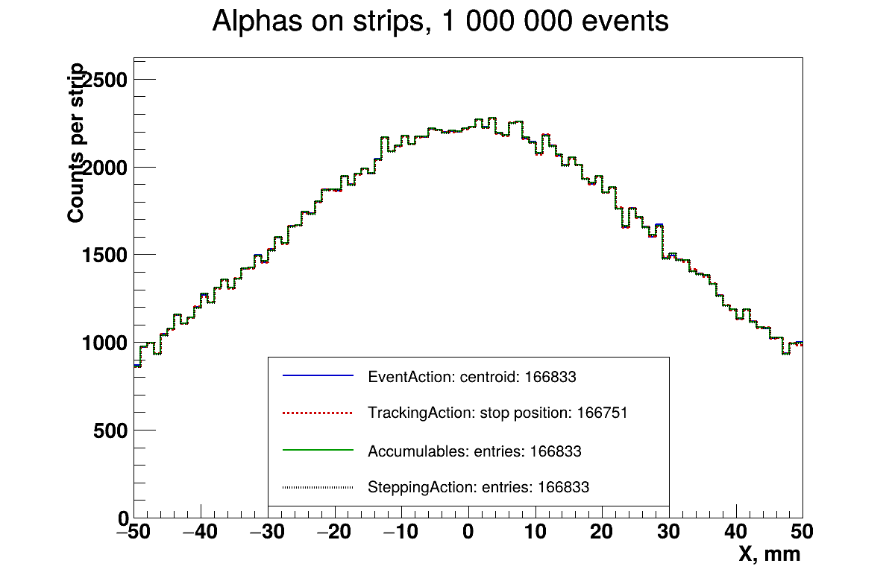
Results: strip distributions
Expected fraction of alphas which hit the detector = solid angle / 4π
  Square with half-side a at distance h: Ω = 4·atan(a² / (h·sqrt(h² + 2a²)))
  a = h = 50 mm: Ω = 2π/3, so 1/6 of events: ~166 667
Simulation: 166 833 alphas entered, 166 833 events with energy, 166 751 alphas stopped in detector
All four look the same!

Slide 20
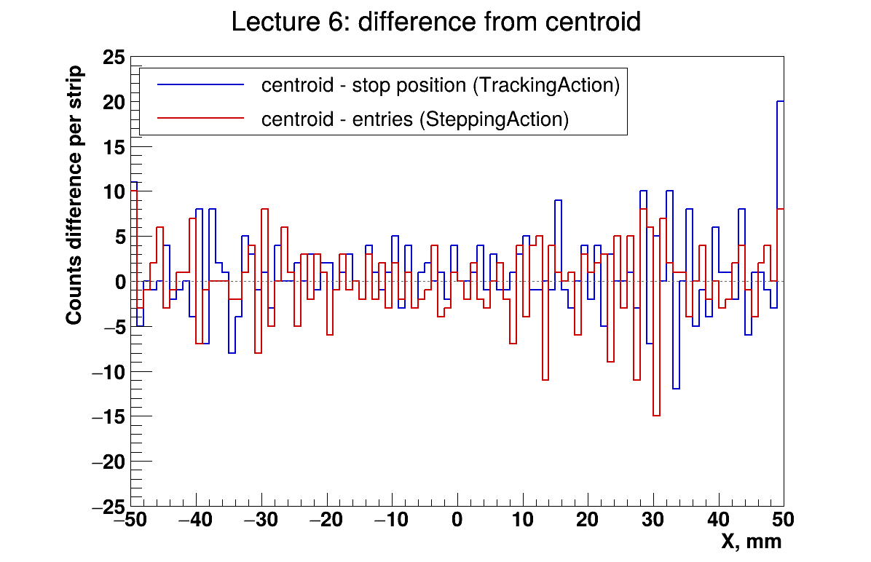
Results: differences
Accumulables and SteppingAction methods are identical in every bin - same condition, only different way to collect and merge data
Picture: centroid minus stop position and centroid minus entries, per strip. They differ by a few counts:
  Alpha range in Si is ~27 um, strip is 1 mm: sometimes alpha enters one strip and goes into the neighbour. Entry is in the first strip, stop - in the second, centroid - where more energy is
  Each strip gets some alphas from one neighbour and loses some to the other - so the difference looks like noise around zero
TrackingAction has 82 alphas less: they entered but did not stop in the detector - mostly left through the side faces, see the edge strips

Slide 21
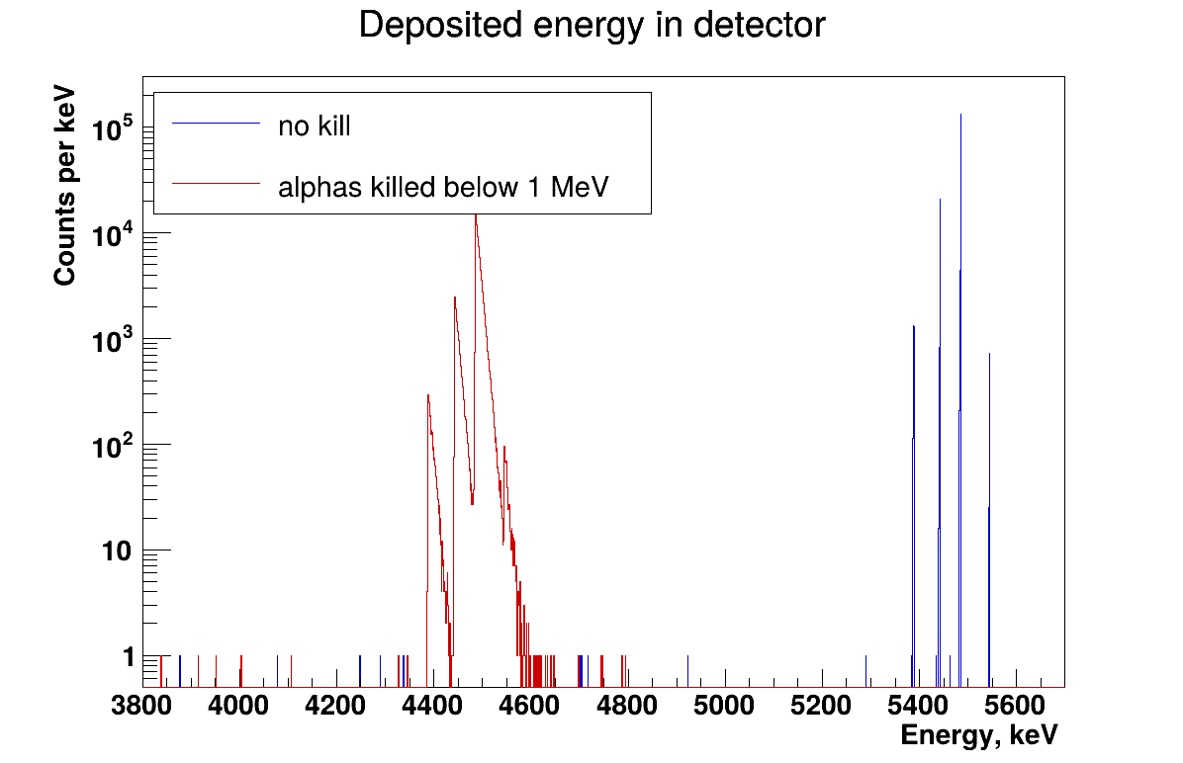
Results: killing alphas below 1 MeV
Without kill: 4 lines of 241Am - 5388, 5443, 5486 and 5544 keV, full energy is deposited
With kill all lines moved 1 MeV down - the rest of alpha energy is lost
  Tails to the right: the last step takes alpha a bit below 1 MeV before we kill it, so a bit more energy is deposited
Time: 20.8 s without kill, 19.1 s with kill – a little faster! We remove the need to track to full energy loss
Can affect position spectra a little – if you kill track earlier, some alphas which could enter second strip stays in the first one

Slide 22
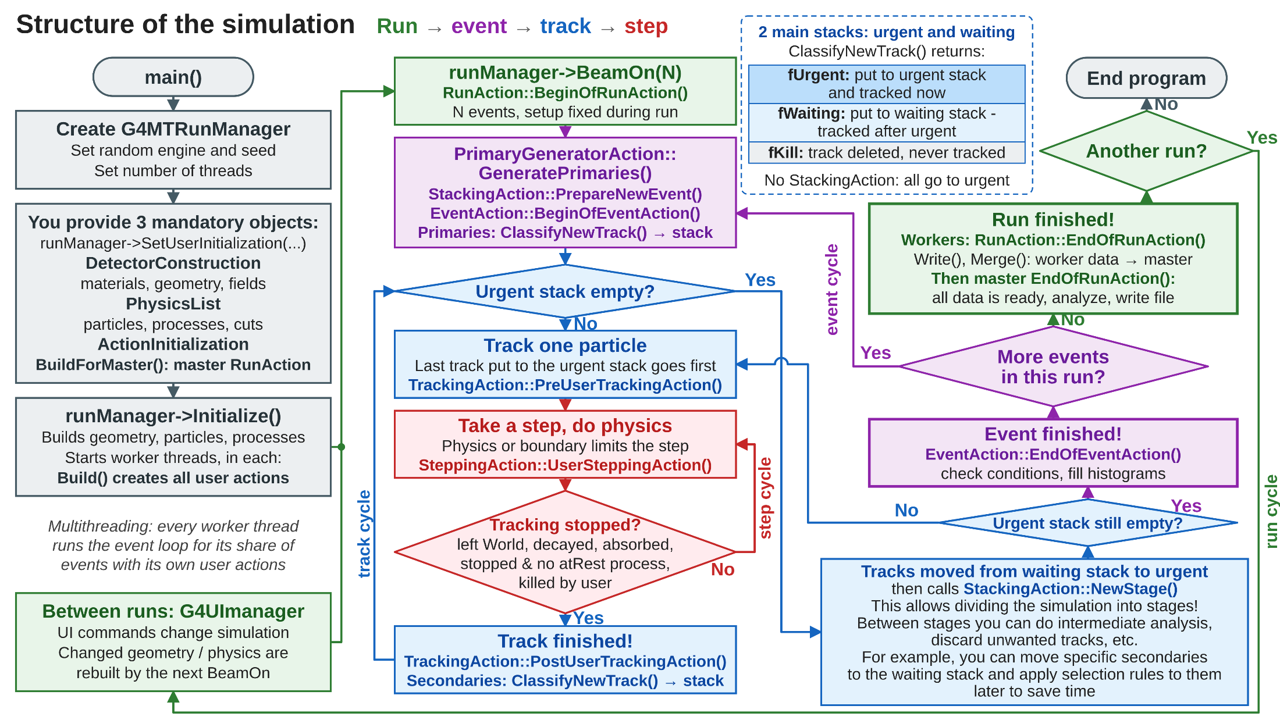

Slide 23
Some homework if you like
Change number of strips to 10 and to 1000. How do centroid and stop position histograms differ from entries histogram now?
Fill the world with air (G4_AIR). What happens? Find a way to change a pressure of air (hint: nistManager->BuildMaterialWithNewDensity and ideal gas law)
Keep the air and move the source to 2 cm and look at the energy spectrum
Count killed primaries in StackingAction and print their fraction at the end of run using accumulable in RunAction and properly passing pointer. What number do you expect?
Kill alphas below 3 MeV. How does energy spectrum change?
Remove the air and add histograms which will collect the range of particle. Use at least two ways to do it (SteppingAction and TrackingAction are the easiest!)

